Slide 1


MTGPredictByImage
CST383
David Kim, Ericka Koyama, james deselms
Notes:
1

Slide 2

Introduction
Can we predict the type of a card based on the cover art image with an accuracy rate higher than random chance, 20%?
page 2
Notes:
Our project, MTGPredictByImage, was undertaken to see if it would be possible to predict the type of a card based on the cover art image with an accuracy rate higher than random chance, 20%. During the creation of the project, our team would discover the steps needed to convert our image data into something a computer can comprehend and use to train a model. In addition, our team would find what is involved in tuning our training model to more accurately predict the right card. Last, we use various other predictors to see if other training models offered a better accuracy result.
2

Slide 3
Selection of Data
page 3
Notes:
3

Slide 4
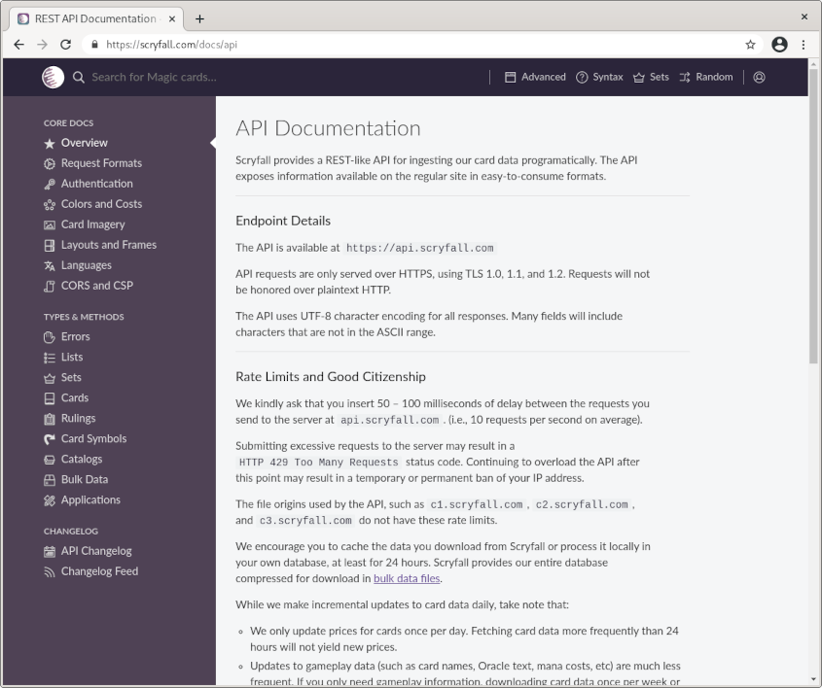
Selection of Data:
Scryfall API
page 4
Notes:
The source of our dataset was from the Scyfall API. The Scryfall API has a wide variety of data available for the cards in the Magic: The Gathering universe. This universe encompasses a wide variety of decks and sets.
Within these sets of cards, the Scryfall API provides information like the title of the card, mana cost, type of creature, card description, cover art, and much more.
4

Slide 5
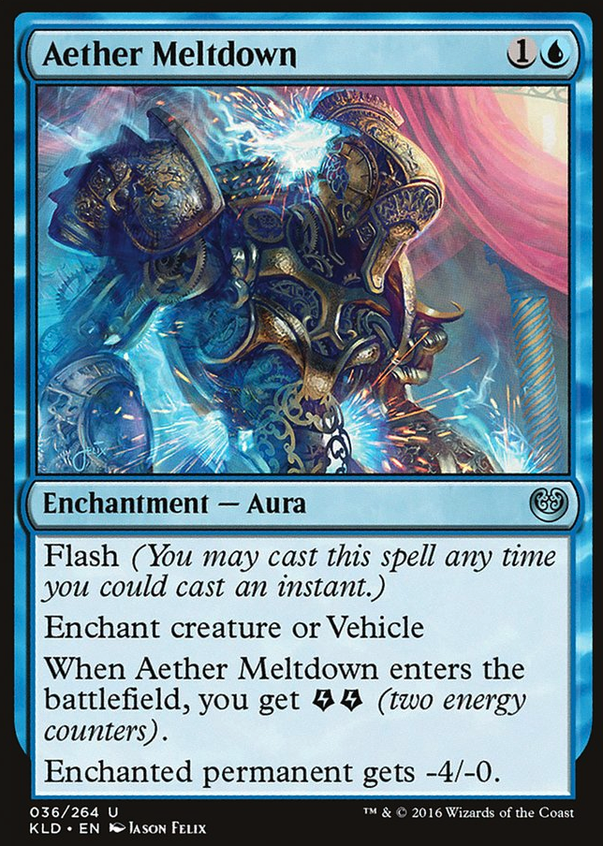
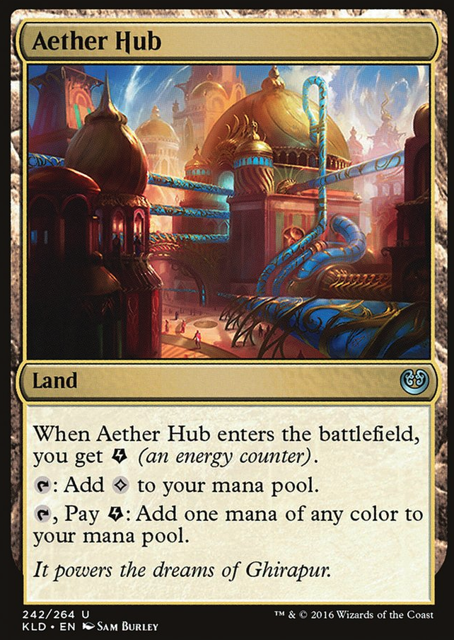
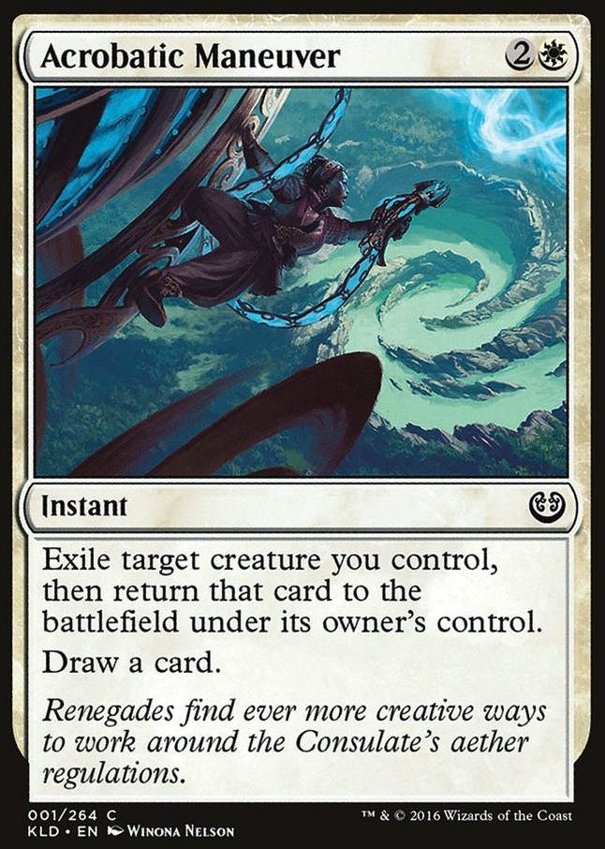
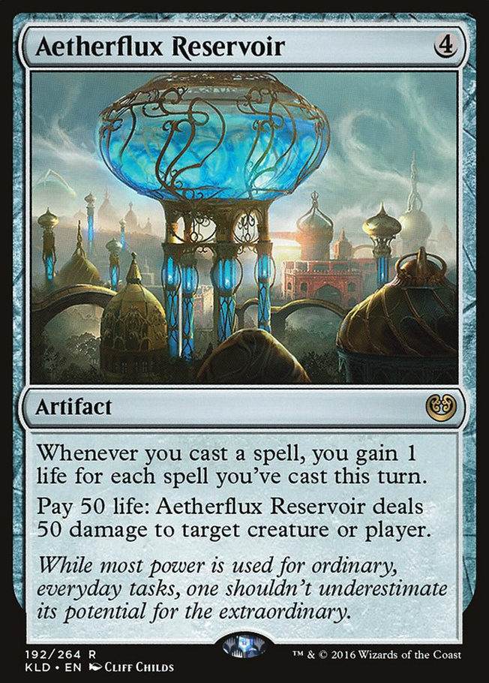
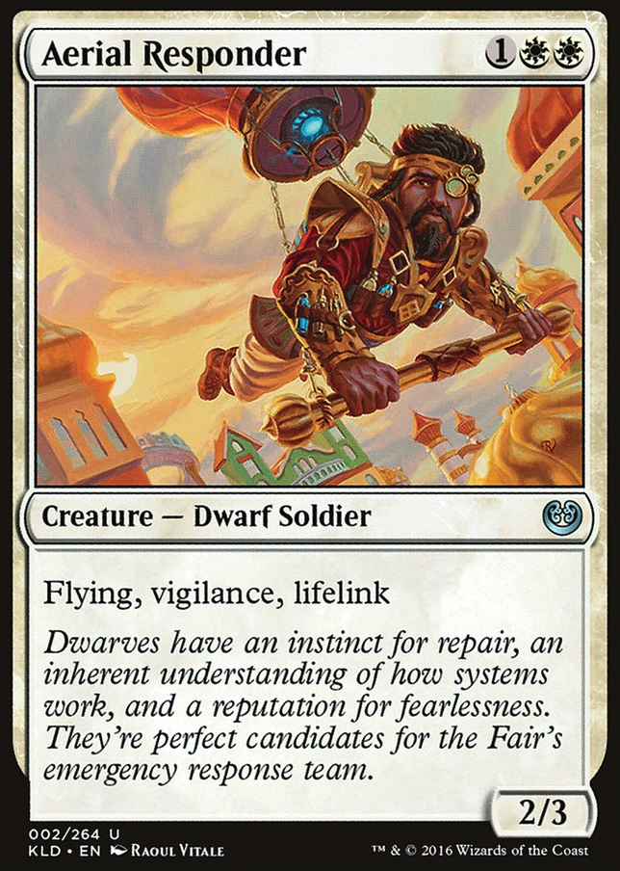
Selection of Data - Types of Cards
Enchantment
Land
Instant or Sorcery
Artifact
Creature
page 5
Notes:
For our data, we selected five types of cards to examine: Enchantment, Land, Instant or Sorcery, Artifact, and Creature.
Enchantments apply an effect to the playing field or game.
Land can be used as a resource.
Instant or Sorcery types apply a spell during your turn or a reaction to the opponents move.
Artifact types have a wide range of uses such as enhancing creatures.
Last, the creature types are your units.
We selected a total of one-hundred twenty-five cards split evenly among the five types.
5

Slide 6
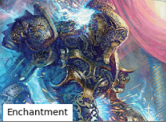
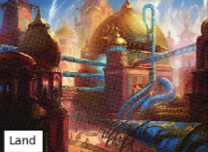
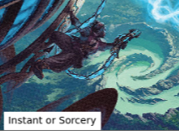
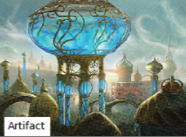
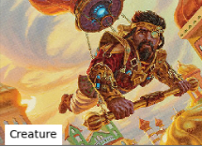
Selection of Data - Types of Cards
Enchantment
Land
Instant or Sorcery
Artifact
Creature
page 6
Notes:
For our data, we selected five types of cards to examine: Enchantment, Land, Instant or Sorcery, Artifact, and Creature.
Enchantments apply an effect to the playing field or game.
Land can be used as a resource.
Instant or Sorcery types apply a spell during your turn or a reaction to the opponents move.
Artifact types have a wide range of uses such as enhancing creatures.
Last, the creature types are your units.
We selected a total of one-hundred twenty-five cards split evenly among the five types.
6

Slide 7
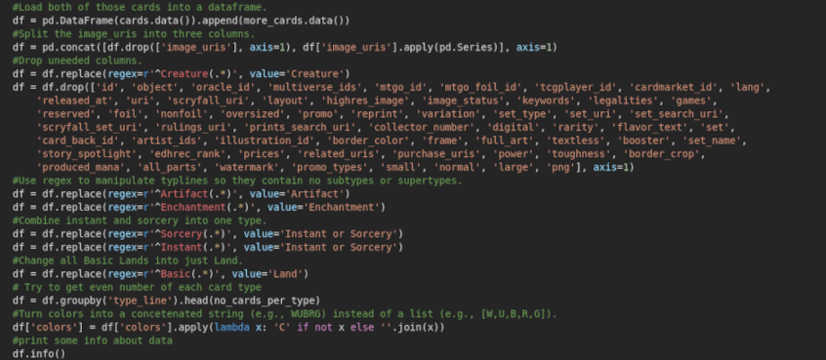
Selection of Data – Data Munging and Feature Engineering
Introduction
Removal of unneeded columns
Modified Type String data
Retrieved and processed image data
page 7
Notes:
For our data, there was a lot of munging required to remove unneeded data. Our team removed sixty-one unneeded features.
As for feature engineering, one of the features our team manipulated was type_line. We modified the string to remove any miscellaneous data that did not specify the type of the card.
The other feature that was processed was the cover art of the card. Our team grabbed the image URL from the Scryfall API and read the raw image data into a numpy array for use with our training model.
The remaining features we retained in the dataset included the name of the card, colors, color identity and several other features.
7

Slide 8
Methods
page 8

Slide 9
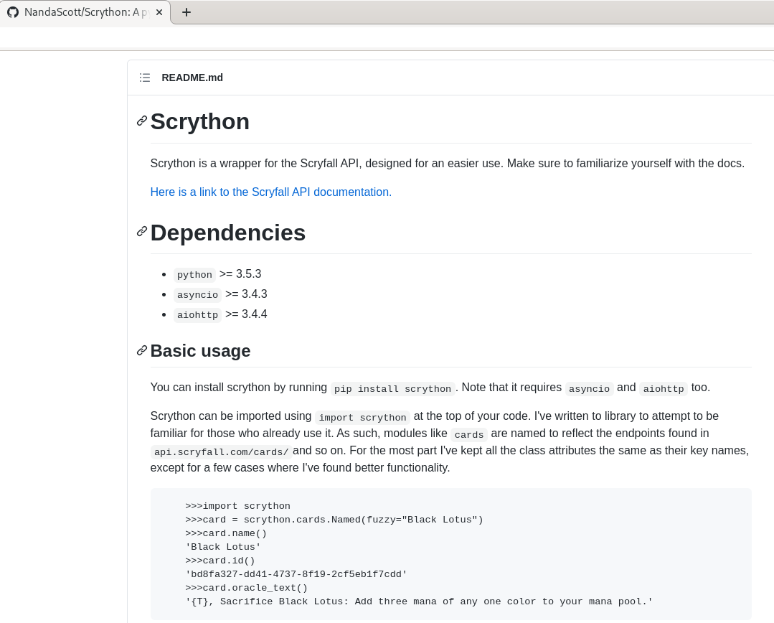
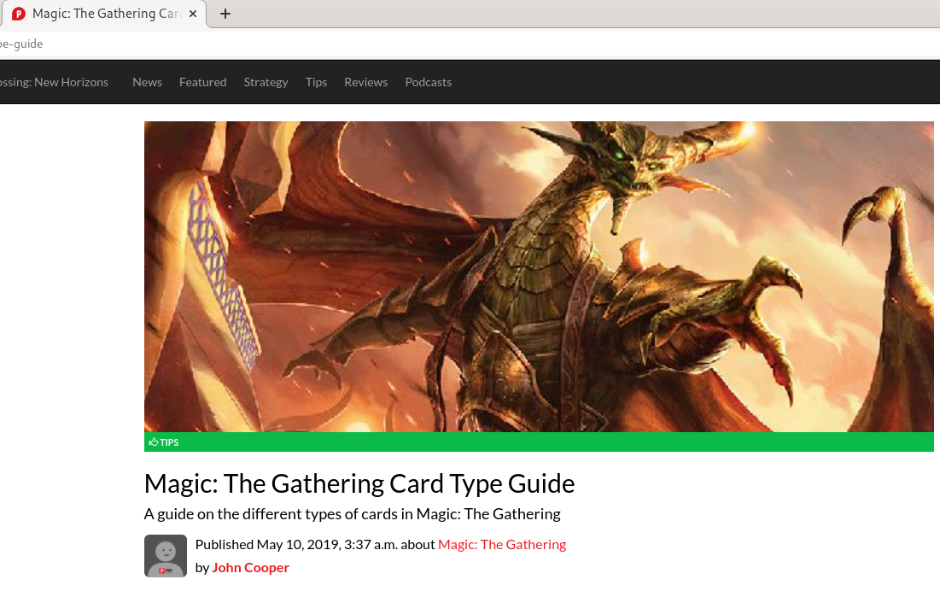
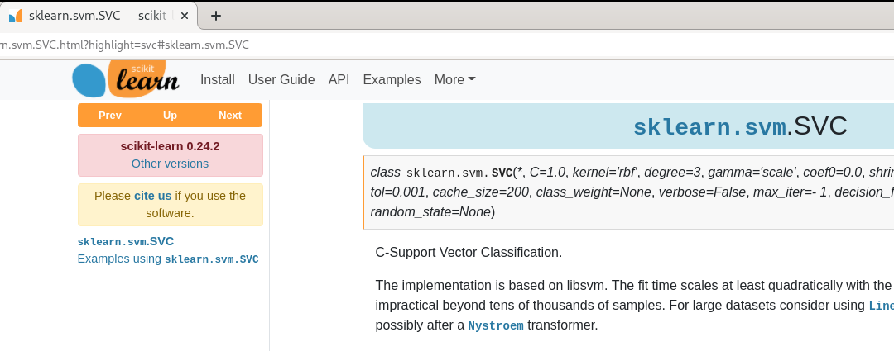
Methods
Scyfall API
Scrython
SVM/SVC from SKLearn
Official and Community Magic: The Gathering Websites
page 9
Notes:
Scyfall API - The Scryfall API was used as the source of our data.
Scrython - The Scrython python library was utilized to access the Scryfall API, previously mentioned in the data section, using native Python methods and commands.
SVM/SVC from SKLearn - For our predictor engine, we utilized the SVM/SVC library from SKLearn.
Official and Community Magic: The Gathering Websites - Our team researched Magic: The Gathering through various official and community driven websites to gather more information about the various data points that could be used within a playing card.
9

Slide 10
Results
page 10

Slide 11
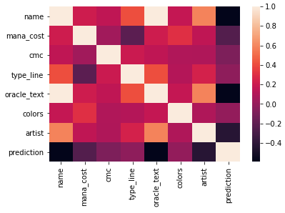
Results - Heatmap
Not many strong correlations.
Strong correlations between name of card and oracle text.
page 11
Notes:
Before creating our training model, our team looked at the features that we gathered from the cards. The heat map revealed that a lot of the features did not correlate strongly. The only features that had a strong correlation was the name of the card and oracle text. The oracle text refers to the official function description of a card by the publisher.
11

Slide 12
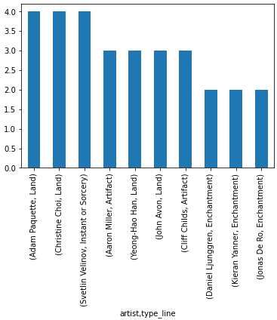
Results – Type of Card
by Artist
Top 10 Highest Ranking Values
page 12
Notes:
In addition, our team plotted which type of card a particular artist created. Our plot shows the top ten highest ranking values. The cards were created from a wide range of artists.
12

Slide 13
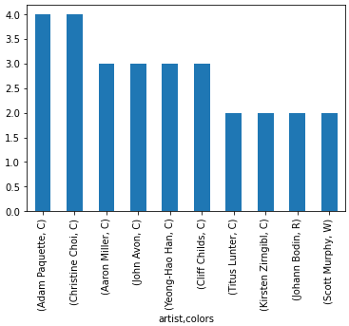
Results – Color
by Artist
Top 10 Highest Ranking Values
page 13
Notes:
Last, our team plotted the color type of a card by a particular artist. Again our plot shows the top ten highest ranking values. Similar to the previous plot, there were a wide range of artists that were associated with the various color types.
13

Slide 14
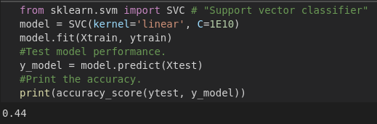
Results – Training Model
75/25 Split
Predictor Engine: SVC
Parameters:
kernel=’linear’
C=1E10
random_state=7
page 14
Notes:
For our training model, we create an 75/25 split between our training and test data, respectively.
Our preferred predictor engine was the SVC library.
We tried other predictor engines, such as SGDClassifier, but those predictor engines, with additional parameter tuning, resulted in lower accuracy scores.
We were able to get the optimal results using the following parameters with the SVC library: kernel=’linear’ and C=1E10. In addition, we found that the random state affected our accuracy results. Our team found the optimal value to be 7.
14

Slide 15
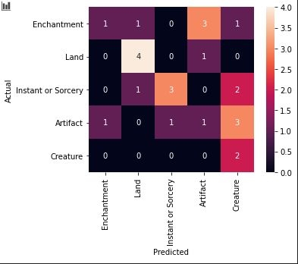
Results – Accuracy
44% accuracy
Creature Type Heavily Miscategorized
Land and Sorcery Types Generally categorically Correct
page 15
Notes:
This tuning resulted in an accuracy of forty-four percent.
Out of all the card types, the creature cards were miscategorized heavily.
The land and instant or sorcery type cards were generaly categorized correctly.
15

Slide 16
Discussion
page 16

Slide 17
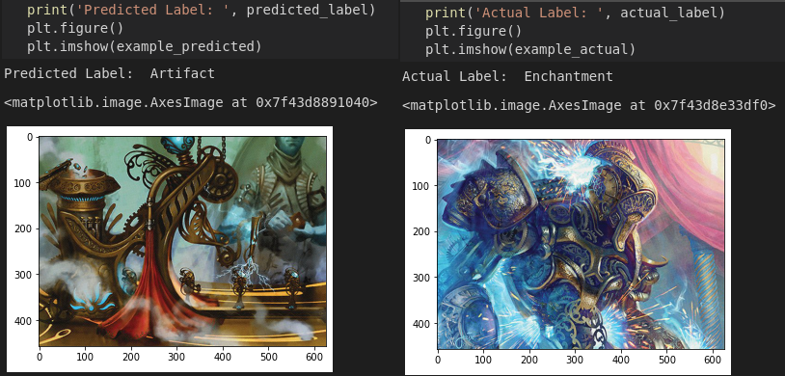
Discussion
Use additional training data at the cost of more Memory and storage.
Improve our training model to distinguish between similar shapes.
page 17
Notes:
This result shows that building an accurate prediction model may require either a lot more data or tuning.
Our training models used a small sample size due to the size of the images. If we were to use a larger dataset, our accuracy with our training model could have performed better.
In addition, our results could improve with additional tuning of our training model. To our training model, the image of a creature versus another type of card may look similar in shape. You can see this occur with the following two cards below. If we were able to implement a solution for our training model to recognize facial or architectural features, this additional knowledge by our training model would likely result in much higher accuracy.
17

Slide 18
SUMMARY
page 18

Slide 19
Achieved our goal for better accuracy than random chance.
Improvements with the training model may be possible.
Summary
Summary tagline or sub-headline
page 19
Notes:
Our team sought out to find a prediction engine that could predict the type of a Magic: The Gathering card just by the cover art, but the training model yielded good results using the SVM/SVC libraries from SKLearn. We found that additional data and tuning would be required to improve the accuracy of our training model if we were to use cover art with our prediction engine.
19

Slide 20
Thank You
David Kim, Ericka Koyama, james deselms
CST383
Notes:
20

Slide 21
Sources
Powerpoint Template: https://templates.office.com/en-US/STEM-pitch-deck-TM12041065
Slide 1,18 Magic the Gathering Logo: https://media.wizards.com/2017/images/daily/41mztsnrdm.jpg
Slide 2, Introduction: https://downloads.healthcatalyst.com/wp-content/uploads/2017/02/machine-learning-in-healthcare.jpg
Slide 3,7,9,15,17 Divider: https://www.icriindia.com/uploads/courses/banner/1a166ab3701560420635.jpg
Slide 4, Selection of Data - Scryfall API: https://scryfall.com/docs/api/cards
Slide 8 Methods:
https://scryfall.com/docs/api/cards
https://github.com/NandaScott/Scrython
https://primagames.com/tips/magic-gathering-card-type-guide
https://scikit-learn.org/stable/modules/generated/sklearn.svm.SVC.html?highlight=svc#sklearn.svm.SVC
page 21

